Slide 1
Dynamic Health Surveillance System
Empowering Lives through Real-time Health Monitoring.

Slide 2
The Team
K HAILEY 22MIS0156
S VIGNESH 22MIS0163
G LAVANAYA 22MIS0148

Slide 3
ABSTRACT
IoT-based health monitoring systems utilize wearable sensors to continuously track vital signs.
Cloud platforms process and analyze the data for real-time health insights.
Enables remote monitoring of patients, early detection of health deterioration, and timely medical intervention.
Improves overall patient care, outcomes, and personalized healthcare

Slide 4
BACKGROUND
IoT technology has transformed health monitoring by integrating sensors that collect real-time health data (heart rate, blood pressure, body temperature).
Wireless sensors capture health data, which is sent to cloud platforms for storage and analysis.
Cloud computing enables healthcare providers to access this data remotely, improving decision-making.
IoT helps in continuous health monitoring, detecting early signs of health issues, and providing actionable insights for timely intervention.

Slide 5
Literature Survery
No. | Title | Authors | Journal/Con -ference | Year | Objectives/Ideas | IoT Components | Advantages | Disadvantages
1 | IoT-Based Health Monitoring and Alert System | A. Smith, B. Lee | Journal of IoT Applications | 2020 | Enables real-time health tracking and alerts. | pulse sensor, esp32,devices | Real-time data and alerts | Privacy issues
2 | Smart Real-Time Health Monitoring Using IoT | C. Brown, D. Kim | HealthTech Conference | 2019 | Uses IoT to monitor and report real-time vitals. | IoT sensors, Analog LM35 Temp,cloud platforms | Real-time insights | Limited scalability
3 | Machine Learning for Health Surveillance Systems | E. Johnson, F. Martin | IEEE IoT Journal | 2021 | Integrates ML into health surveillance systems. | ML models, Pulse-Ox & Heart Rate Sensor | Predictive insights | High computational cost

Slide 6
No. | Title | Authors | Journal/Con -ference | Year | Objectives/Ideas | IoT Components | Advantages | Disadvantages
4 | IoT-Driven Health Diagnostics Using AI | G. Clark, H. Patel | ACM Health Analytics | 2022 | Combines IoT and AI for health diagnostics. | AI platforms, IoT sensors, esp32 | Advanced diagnostics | Data management complexity
5 | Wireless Health Monitoring Applications | I. Lewis, J. Wong | IoT World Forum | 2020 | Focuses on wireless applications for health IoT. | Heart Rate Sensor,cloud platforms | Enhanced mobility | Network dependency
6 | Tracking Dynamic Health Properties in Real-Time | K. Turner, L. Ramirez | International IoT Congress | 2021 | Develops methods to track health data in real time. | IoT platforms, Pulse-Ox & Heart Rate Sensor | Better real-time accuracy | Limited deployment scale

Slide 7
No. | Title | Authors | Journal/Con -ference | Year | Objectives/Ideas | IoT Components | Advantages | Disadvantages
7 | Real-Time Wireless Health Monitoring Applications | P.White, R.Hall | IDC Online | 2018 | Focus on real-time health monitoring through wireless IoT applications. | Wireless IoT devices | Enhanced mobility | Network dependency
8 | Real-Time Health Monitoring | M.Green, T.Johnson | IEEE | 2019 | Uses real-time systems for monitoring health metrics. | IoT platforms, Health monitoring sensors | Real-time health insights | Computational limitations

Slide 8
Thank You !

Slide 9
Dynamic Health Surveillance System
Empowering Lives through Real-time Health Monitoring.

Slide 10
Overview of Existing Systems
Current health monitoring systems are primarily hospital-based or rely on wearable devices that transmit data to local storage or cloud servers. These include:
•
Traditional patient monitoring systems used in hospitals, which require professional supervision.•
Wearable smartwatches that track vitals but may lack clinical accuracy.
IoT-based health monitoring solutions, which are relatively new but often require complex setups and high maintenance costs.

Slide 11
Limitations
Despite advancements, existing systems have several drawbacks:
Limited Remote Access: Many systems do not provide real-time monitoring outside of hospital settings.
High Cost: Advanced health monitoring devices are expensive, making them less accessible.
Energy Inefficiency: Many wearable devices have short battery lives, requiring frequent recharges.
Lack of Continuous Monitoring: Some devices only collect periodic data, missing critical health fluctuations.
Connectivity Issues: Certain systems require stable internet connections, which may not always be available

Slide 12
Proposed Methodologies
Motivation
The increasing need for real-time health monitoring, especially for elderly and chronically ill patients, necessitates a cost-effective and accessible solution. The Dynamic Health Surveillance System (DHSS) aims to bridge the gap by leveraging IoT technologies for real-time patient monitoring and alerts.
Objectives
Develop a reliable and affordable health surveillance system.
Ensure real-time monitoring and data visualization through a mobile application.
Provide timely alerts using LED and buzzer indicators.
Enable remote access for doctors and caregivers via cloud integration.
Ensure low-power consumption for long-term use.

Slide 13
Development of Tools and Methodologies
Hardware:
ESP8266 (Microcontroller with Wi-Fi capabilities)
Pulse Sensor (Heart Rate Measurement)
DHT11 (Humidity and Room Temperature Sensor)
DS18B20 (Body Temperature Sensor)
LCD Display (Real-time data output)
Buzzer and LED (Alert mechanisms)
Software:
Arduino IDE for programming
Blynk Application for cloud-based visualization
2.4 GHz Wi-Fi communication protocols for real-time data transfer
Methodology
1.Sensor Integration: Collecting health parameters such as heart rate, body temperature, and room conditions.
2.Data Processing: ESP8266 processes the acquired data and applies threshold values.
3.Cloud Integration: Data is transmitted to the Blynk cloud for remote access and storage.
4.Alert Mechanism: Abnormal readings trigger an LED and buzzer alert.
5.User Interface: Data is displayed on both an LCD screen and the Blynk app.

Slide 14
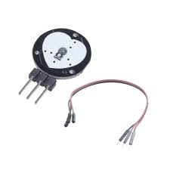
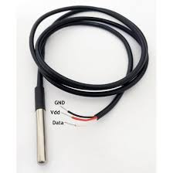
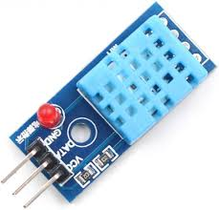
Identification of Components
Pulse Sensor
Sensors
•Pulse Sensor: Measures real-time heart rate.
•DHT11 Sensor: Records room temperature and humidity.
•DS18B20 Sensor: Monitors body temperature.
Actuators
•LED Indicator: Lights up when pulse levels drop below normal.
•Buzzer Alarm: Sounds an alert when critical health conditions are detected.
Smart Objects
•ESP8266 Microcontroller: Processes data and connects to Wi-Fi.
•Blynk App: Provides a real-time visualization of patient vitals on a mobile platform.
System Specification
•Microcontroller: ESP8266 NodeMCU
•Connectivity: Wi-Fi-based data transmission
•Data Reporting Interval: 1 second
•Power Supply: 5V (via USB or battery)
•Alert Mechanism: LED and buzzer notification system
DS18B20 Sensor
DHT11 Sensor

Slide 15
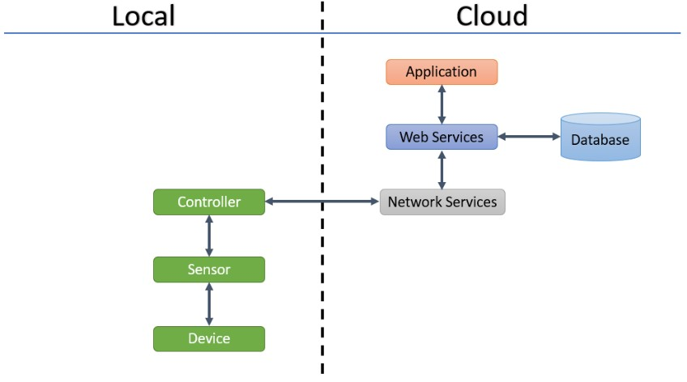
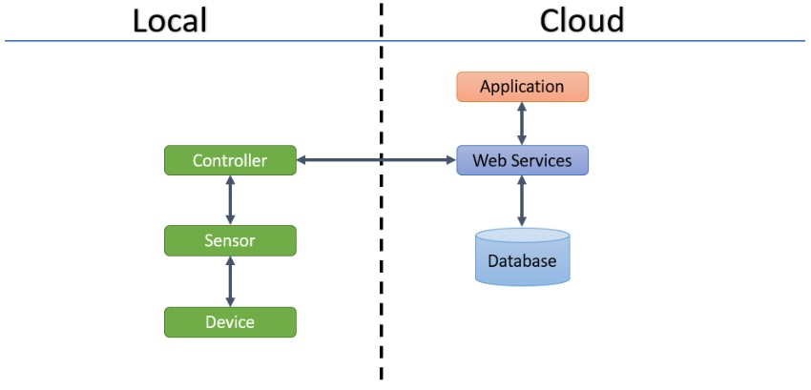
IoT Level Specifications
•IoT Level 1: Sensor-based real-time data collection
•IoT Level 2: Cloud-based storage and remote accessibility
•IoT Level 3: Data analytics and historical tracking via the Blynk platform
IoT Level 3
IoT Level 2

Slide 16
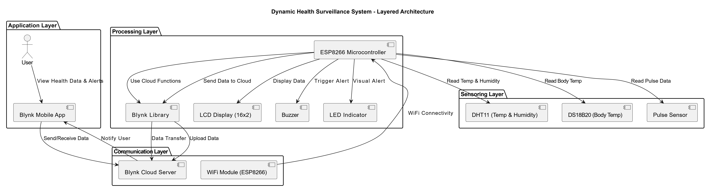
System Architecture

Slide 17
Dynamic Health Surveillance System
Empowering Lives through Real-time Health Monitoring.

Slide 18
Coding or Implementation
The implementation of the Dynamic Health Surveillance System (DHSS) involves the integration of multiple sensors and communication modules using ESP8266 NodeMCU. The primary functionalities of the system include real-time health monitoring, data visualization, and alert mechanisms.
Code Overview:
• Wi-Fi Connectivity: ESP8266 connects to the internet using predefined SSID and password.
• Sensor Integration: The system collects real-time data from the Pulse Sensor, DHT11 (room temperature & humidity), and DS18B20 (body temperature).
• Data Processing: The microcontroller processes sensor values and applies threshold conditions.
• Blynk Cloud Integration: The system transmits data to Blynk, enabling remote monitoring.
• Alert Mechanism: If abnormal readings are detected, the buzzer and LED are triggered to alert caregivers.
• LCD Display: Real-time health parameters are displayed on a 16x2 LCD.

Slide 19
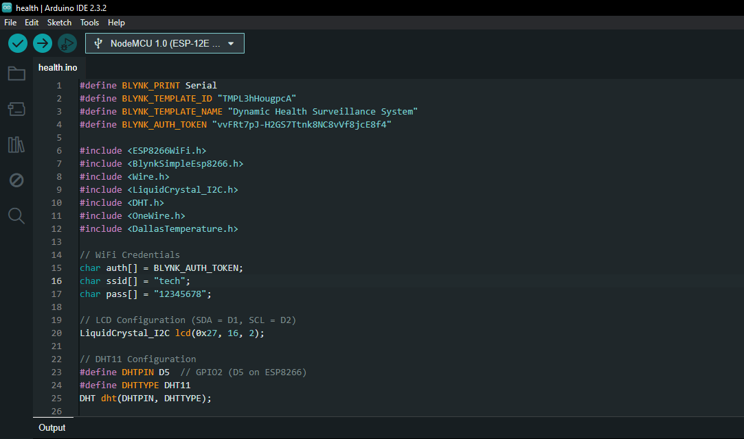
Coding or Implementation

Slide 20
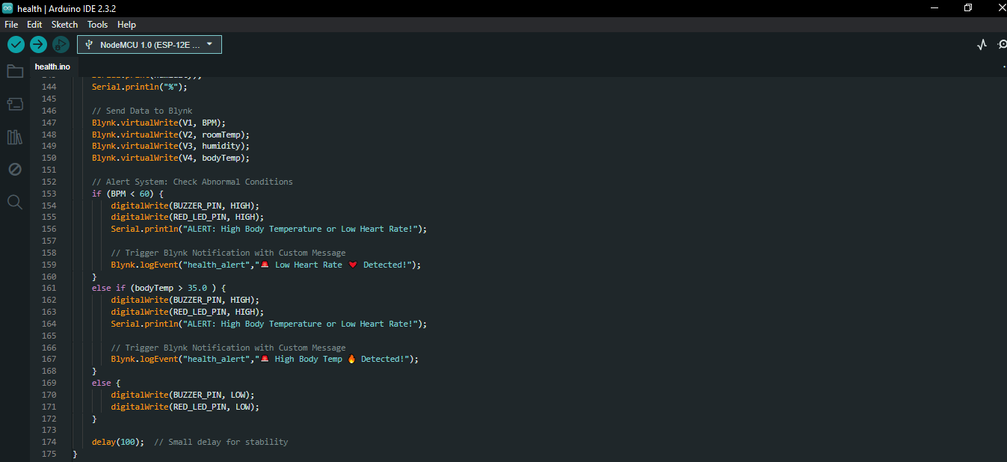
Coding or Implementation

Slide 21
Testing
Test Case ID | Test Description | Input/Condition | Expected Output
TC-01 | Verify Wi-Fi connection to Blynk | Correct Wi-Fi credentials and Blynk Auth Token | Blynk connected successfully, no errors on Serial Monitor
TC-02 | Validate DHT11 readings (Room Temp & Humidity) | Room Temp 25°C, Humidity 50% | LCD & Blynk display correct values
TC-03 | Validate DS18B20 body temperature reading | Body Temp 36°C | LCD & Blynk display correct values
TC-04 | Validate Pulse Sensor BPM Reading | Simulated BPM of 80 | LCD & Blynk display correct BPM value
TC-05 | Check LCD display updates | Sensors connected, system running | LCD displays BPM, Room Temp, Body Temp, Humidity correctly

Slide 22
TC-06 | Verify Buzzer and LED on abnormal condition (Low BPM) | BPM < 60 | Buzzer & LED activate, Blynk notification sent
TC-07 | Verify Buzzer and LED on abnormal condition (High Temp) | Body Temp > 35°C | Buzzer & LED activate, Blynk notification sent
TC-08 | Validate normal condition (No alerts) | BPM = 80, Body Temp = 36°C, Room Temp = 25°C | Buzzer & LED remain off, no Blynk notification
TC-09 | Validate Blynk notifications | Abnormal conditions triggered | Correct Blynk logEvent message displayed on the app
TC-10 | Test sensor error handling (DS18B20 disconnected) | Disconnect DS18B20 | Error message on Serial Monitor, bodyTemp shows -127°C

Slide 23
Conclusion and Future Enhancements
The Dynamic Health Surveillance System successfully enables real-time monitoring of vital health parameters. It provides:
•Continuous tracking of heart rate, body temperature, room temperature, and humidity.
•Cloud-based remote monitoring via Blynk.
•Instant alerts in case of critical conditions.
This system can be deployed in homes, hospitals, and elderly care centers to enhance healthcare monitoring.
Future Enhancements:
To improve functionality and usability, the following enhancements are proposed:
•Machine Learning for Predictive Analysis: Implement AI-based models to predict health deterioration.
•Wearable Integration: Develop a compact, wearable version for enhanced mobility.
•Battery Optimization: Increase power efficiency for prolonged usage.
• Additional Sensors: Integrate SpO2 and ECG sensors for more comprehensive health monitoring

Slide 24
• References
1.https://www.youtube.com/watch?v=xBRV3WNg5gA&pp=ygUmaGVhbHRoIG1vbml0b3Jpbmcgc3lzdGVtIHVzaW5nIGVzcDgyNjY%3D 2.https://www.youtube.com/watch?v=BSuCI8BeJC0&pp=ygUmaGVhbHRoIG1vbml0b3Jpbmcgc3lzdGVtIHVzaW5nIGVzcDgyNjY%3D 3.https://www.youtube.com/watch?v=EqYfCUCbVAk&pp=ygUmaGVhbHRoIG1vbml0b3Jpbmcgc3lzdGVtIHVzaW5nIGVzcDgyNjY%3D 4.https://www.instructables.com/Patient-Health-Monitoring-Based-on-IOT-Using-ESP82/ 5.https://ijhssm.org/issue_dcp/Health%20Monitoring%20System%20Using%20Arduino%20And%20ESP8266.pdf

Slide 25
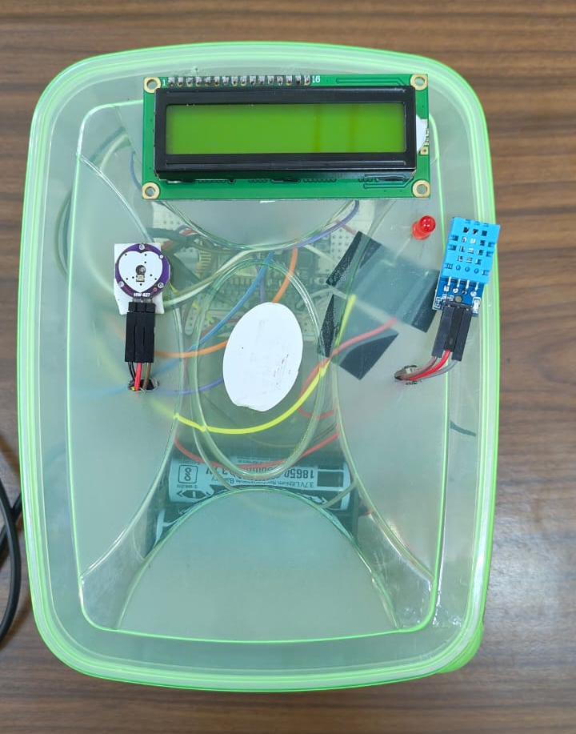
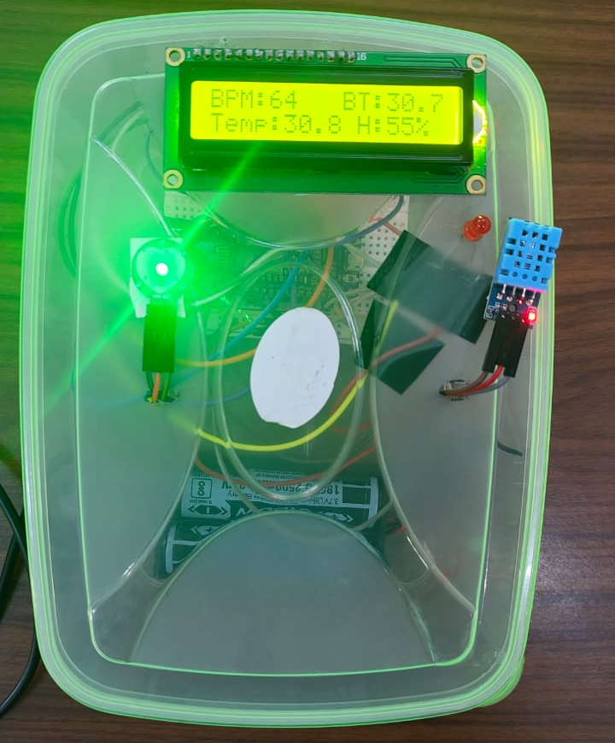
• Snapshot of Project

Slide 26
